Slide 1
Work Journal One
Standard Dive and Strategy Share Out

Slide 2
Work Journal Overview and Bucket Standards
First Grade
CCSS.ELA-Literacy.RL.1.2 Retell stories, including key details, and demonstrate understanding of their central message or lesson.
CCSS.ELA-Literacy.RL.1.3 Describe characters, settings, and major events in a story, using key details.
CCSS.ELA-LITERACY.RI.1.2 Identify the main topic and retell key details of a text.
CCSS.ELA-LITERACY.RI.1.3 Describe the connection between two individuals, events, ideas, or pieces of information in a text.
Yearlong/ Writing Standard
CCSS.ELA-LITERACY.RL.1.10 With prompting and support, read prose and poetry of appropriate complexity for grade 1.

Slide 3
Reading
First Grade
Reading Literature
CCSS.ELA-Literacy.RL.1.2 Retell stories, including key details, and demonstrate understanding of their central message or lesson.
CCSS.ELA-Literacy.RL.1.3 Describe characters, settings, and major events in a story, using key details.
Reading Information
CCSS.ELA-LITERACY.RI.1.2 Identify the main topic and retell key details of a text.
CCSS.ELA-LITERACY.RI.1.3 Describe the connection between two individuals, events, ideas, or pieces of information in a text.
Second Grade
Reading Literature
CCSS.ELA-LITERACY.RL.2.2 Recount stories, including fables and folktales from diverse cultures, and determine their central message, lesson, or moral.
CCSS.ELA-LITERACY.RL.2.3 Describe how characters in a story respond to major events and challenges.
Reading Information
CCSS.ELA-LITERACY.RI.2.2 Identify the main topic of a multiparagraph text as well as the focus of specific paragraphs within the text.
CCSS.ELA-LITERACY.RI.2.3 Describe the connection between a series of historical events, scientific ideas or concepts, or steps in technical procedures in a text.

Slide 4
I Can Version of Standard
2.RL.1 I can ask and answer questions about a text.
2.RL.2 I can retell stories with understanding.
2.RL.3 I can describe how characters behave and think in a story.

Slide 5
Reading Strategy List

Slide 6
Fables, Fairy Tales, and Mythology Oh My

Slide 7
A Great Read Aloud

Slide 8
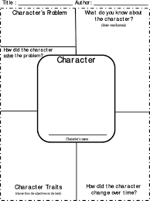
Character Maps

Slide 9
Digging Deep Questions

Slide 10
Reading Jobs

Slide 11
Math
First Grade
1st Grade: Georgia State 1st Grade Unit 3
https://www.georgiastandards.org/Georgia-Standards/Frameworks/1st-Math-Unit-3.pdf
Represent and solve problems involving addition and subtraction. MGSE1.OA.1. Use addition and subtraction within 20 to solve word problems involving situations of adding to, taking from, putting together, taking apart, and comparing, with unknowns in all positions, e.g., by using objects, drawings, and equations with a symbol for the unknown number to represent the problem.
Understand and apply properties of operations and the relationship between addition and subtraction. MGSE1.OA.3. Apply properties of operations as strategies to add and subtract. MGSE1.OA.4. Understand subtraction as an unknown-addend problem.
Add and subtract within 20 MGSE1.OA.5. Relate counting to addition and subtraction (e.g., by counting on 2 to add 2).MGSE1.OA.6 Add and subtract within 20.
Work with addition and subtraction equations MGSE1.OA.7 Understand the meaning of the equal sign, and determine if equations involving addition and subtraction are true or false MGSE1.OA.8 Determine the unknown whole number in an addition or subtraction equation relating to three whole numbers
Represent and interpret data. MGSE1.MD.4. Organize, represent, and interpret data with up to three categories; ask and answer questions about the total number of data points, how many in each category, and how many more or less are in one category than in another.
Second Grade
2nd Grade: Georgia State 2nd Grade Unit 2
https://www.georgiastandards.org/Georgia-Standards/Frameworks/2nd-Math-Unit-2.pdf
Represent and solve problems involving addition and subtraction. MGSE2.OA.1 Use addition and subtraction within 100 to solve one and two step word problems by using drawings and equations with a symbol for the unknown number to represent the problem. Problems include contexts that involve adding to, taking from, putting together/taking apart (part/part/whole) and comparing with unknowns in all positions.
Add and subtract within 20.MGSE2.OA.2 Fluently add and subtract within 20 using mental strategies. By end of Grade 2, know from memory all sums of two one-digit numbers.
Use place value understanding and properties of operations to add and subtract. MGSE2.NBT.5 Fluently add and subtract within 100 using strategies based on place value, properties of operations, and/or the relationship between addition and subtraction.
Work with time and money. MGSE2.MD.8 Solve word problems involving dollar bills, quarters, dimes, nickels, and pennies, using $ and ¢ symbols appropriately.
Represent and interpret data MGSE2.MD.10 Draw a picture graph and a bar graph (with single-unit scale) to represent a data set with up to four categories. Solve simple put-together, take-apart, and compare problems using information presented in a bar graph

Slide 12
I Can Standards Math
First Grade
I can use strategies to solve addition word problems. 1.OA.1
I can use an addition fact to help me answer a subtraction problem. 1.OA.4
I can count to help me add and subtract. 1.OA.5
I know what an equal sign means. 1.OA.7
I can understand data
Second Grade
2.OA.1 I can solve addition and subtraction word problems within 100.
2.OA.2 I can fluently add and subtract within 20.
2.NBT.5 I can fluently add and subtract within 100.
2.MD.8 I can solve money word problems.
2.MD.10 I can show data on a picture graph and a bar graph. I can analyze data in a bar graph.

Slide 13
Math Strategy List

Slide 14
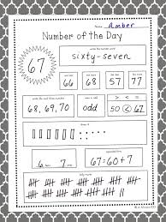
Number of The Day

Slide 15
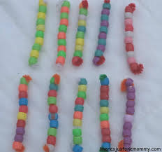
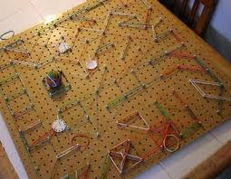
Home Made Manipulatives-Counters, Tens Blocks, Geo Boards

Slide 16
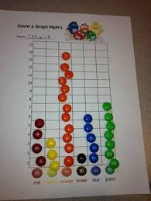
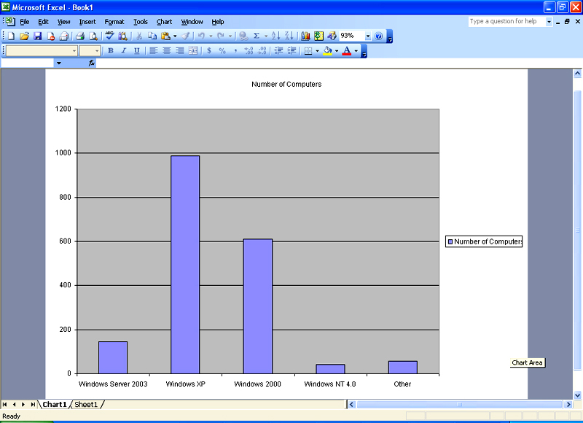
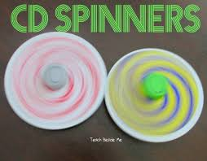
Graphing: Ditch the Paper

Slide 17
Writing I Can Standards
First Grade
I can write about the order of things that happened in a book I read or heard.
• I can use words that show order.
Second Grade
I can write about something that happened, what I have seen, or something I remember. • I can include actions, thoughts, and feelings in my writing. •
I can write a closing statementI can answer a question by thinking about something that happened to me.

Slide 18
Writing Strategy List

Slide 19
Drawing and Labeling to Support Writing

Slide 20
Narratives-Make Believe and Personal

Slide 21
Paper Choice: Convey Expectations and Getting What You Want

Slide 22
Stretching out Small Moments

Slide 23
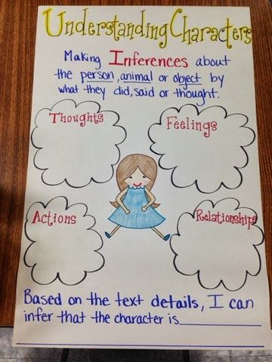
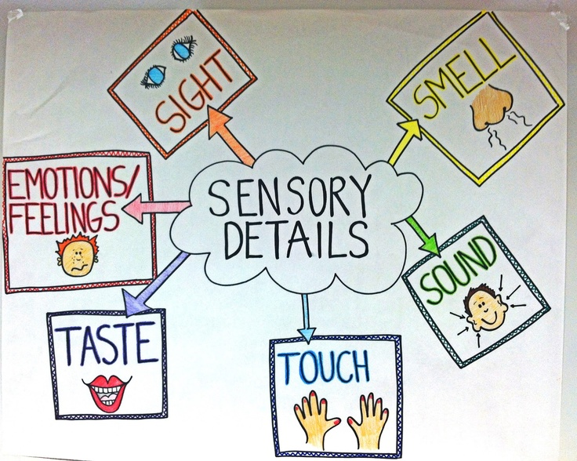
Anchor Charts-Character Thoughts and Feelings, Sequencing and Sensory Details

Slide 24
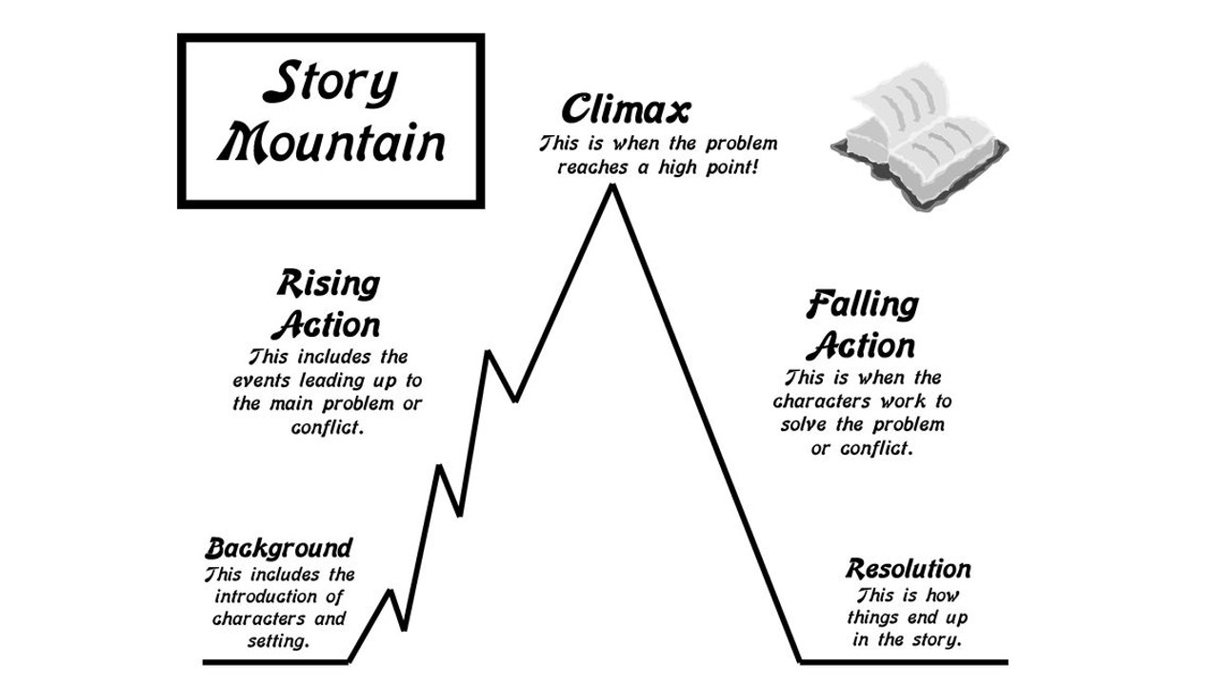
Character Maps and Story Mountains

