Slide 1
Welcome to Core 2

Slide 2


Communication/Contact Info
Da Vinci Innovation Academy
Resource Site: www.davincik8.org
Website: www.davincischools.org
Phone: (310) 725-5800
Twitter: @DaVinciK8
Facebook: DaVinciInnovation
Newsletter: Sent to your email every weekend. Read it!
Teacher Contact Info
Teacher’s e-mail: jfrancy@davincischools.org
DP: http://jennifercore2.weebly.com/
Preferred/best way to reach us: email/Remind 101

Slide 3
Core 2: Classroom Schedule
9:05-9:15 Welcome: Get Ready
9:15-9:50 Morning Meeting
10:00-10:40 Writing
10:40-11:00 Body Break
11:00-12:05 Project Time
12:05-12:50 Lunch
12:50-1:05 Quiet Time
1:05-2:00 Math
2:00-2:20 Body Break
2:20 -3:00 Reading
3:00-3:15 Closing Circle
Schedule is subject to change without notice

Slide 4

Core 2 Birthday Policy
As per our school policy, we will be celebrating birthdays without edible treats. We encourage class celebrations. Here are some suggestions:
  Parent reads a book to the class.
  Donate a book to the class.
  Small gifts for all classmates (ex: pencils, erasers, stickers, etc.)
  If you pass out invitations at school, you need to invite the entire class. Otherwise, you can send out the invitations by mail.
  Please reach out to the teacher to plan a celebration date and time

Slide 5

Math Focus
Math Talks:
http://mathsolutions.com/classroom-lessons/
http://www.insidemathematics.org/classroom-videos/number-talks
Math Games:
http://www.nctm.org/publications/teaching-children-mathematics/blog/why-play-math-games_/
Math Projects:
http://www.ct4me.net/
Engage NY
https://www.engageny.org/

Slide 6

Core 2 Writing Focus
Thoughtful Learning Student Writing Models
https://k12.thoughtfullearning.com/resources/studentmodels
Florida Center for Reading Research (scroll to the bottom for phonemic awareness, phonics, vocabulary, and comprehension
Grades K-1: http://www.fcrr.org/resources/resources_sca_k-1.html
Grades 2-3: http://www.fcrr.org/resources/resources_sca_2-3.html
Expository Writing:
http://www.time4writing.com/writing-resources/expository-essay/
Writing A-Z:
http://www.writinga-z.com
Language Skills:
http://www.funenglishgames.com/grammargames.html http://www.slimekids.com/games/grammar-games/
https://www.eduplace.com/kids/hme/k_5/grammar/

Slide 7
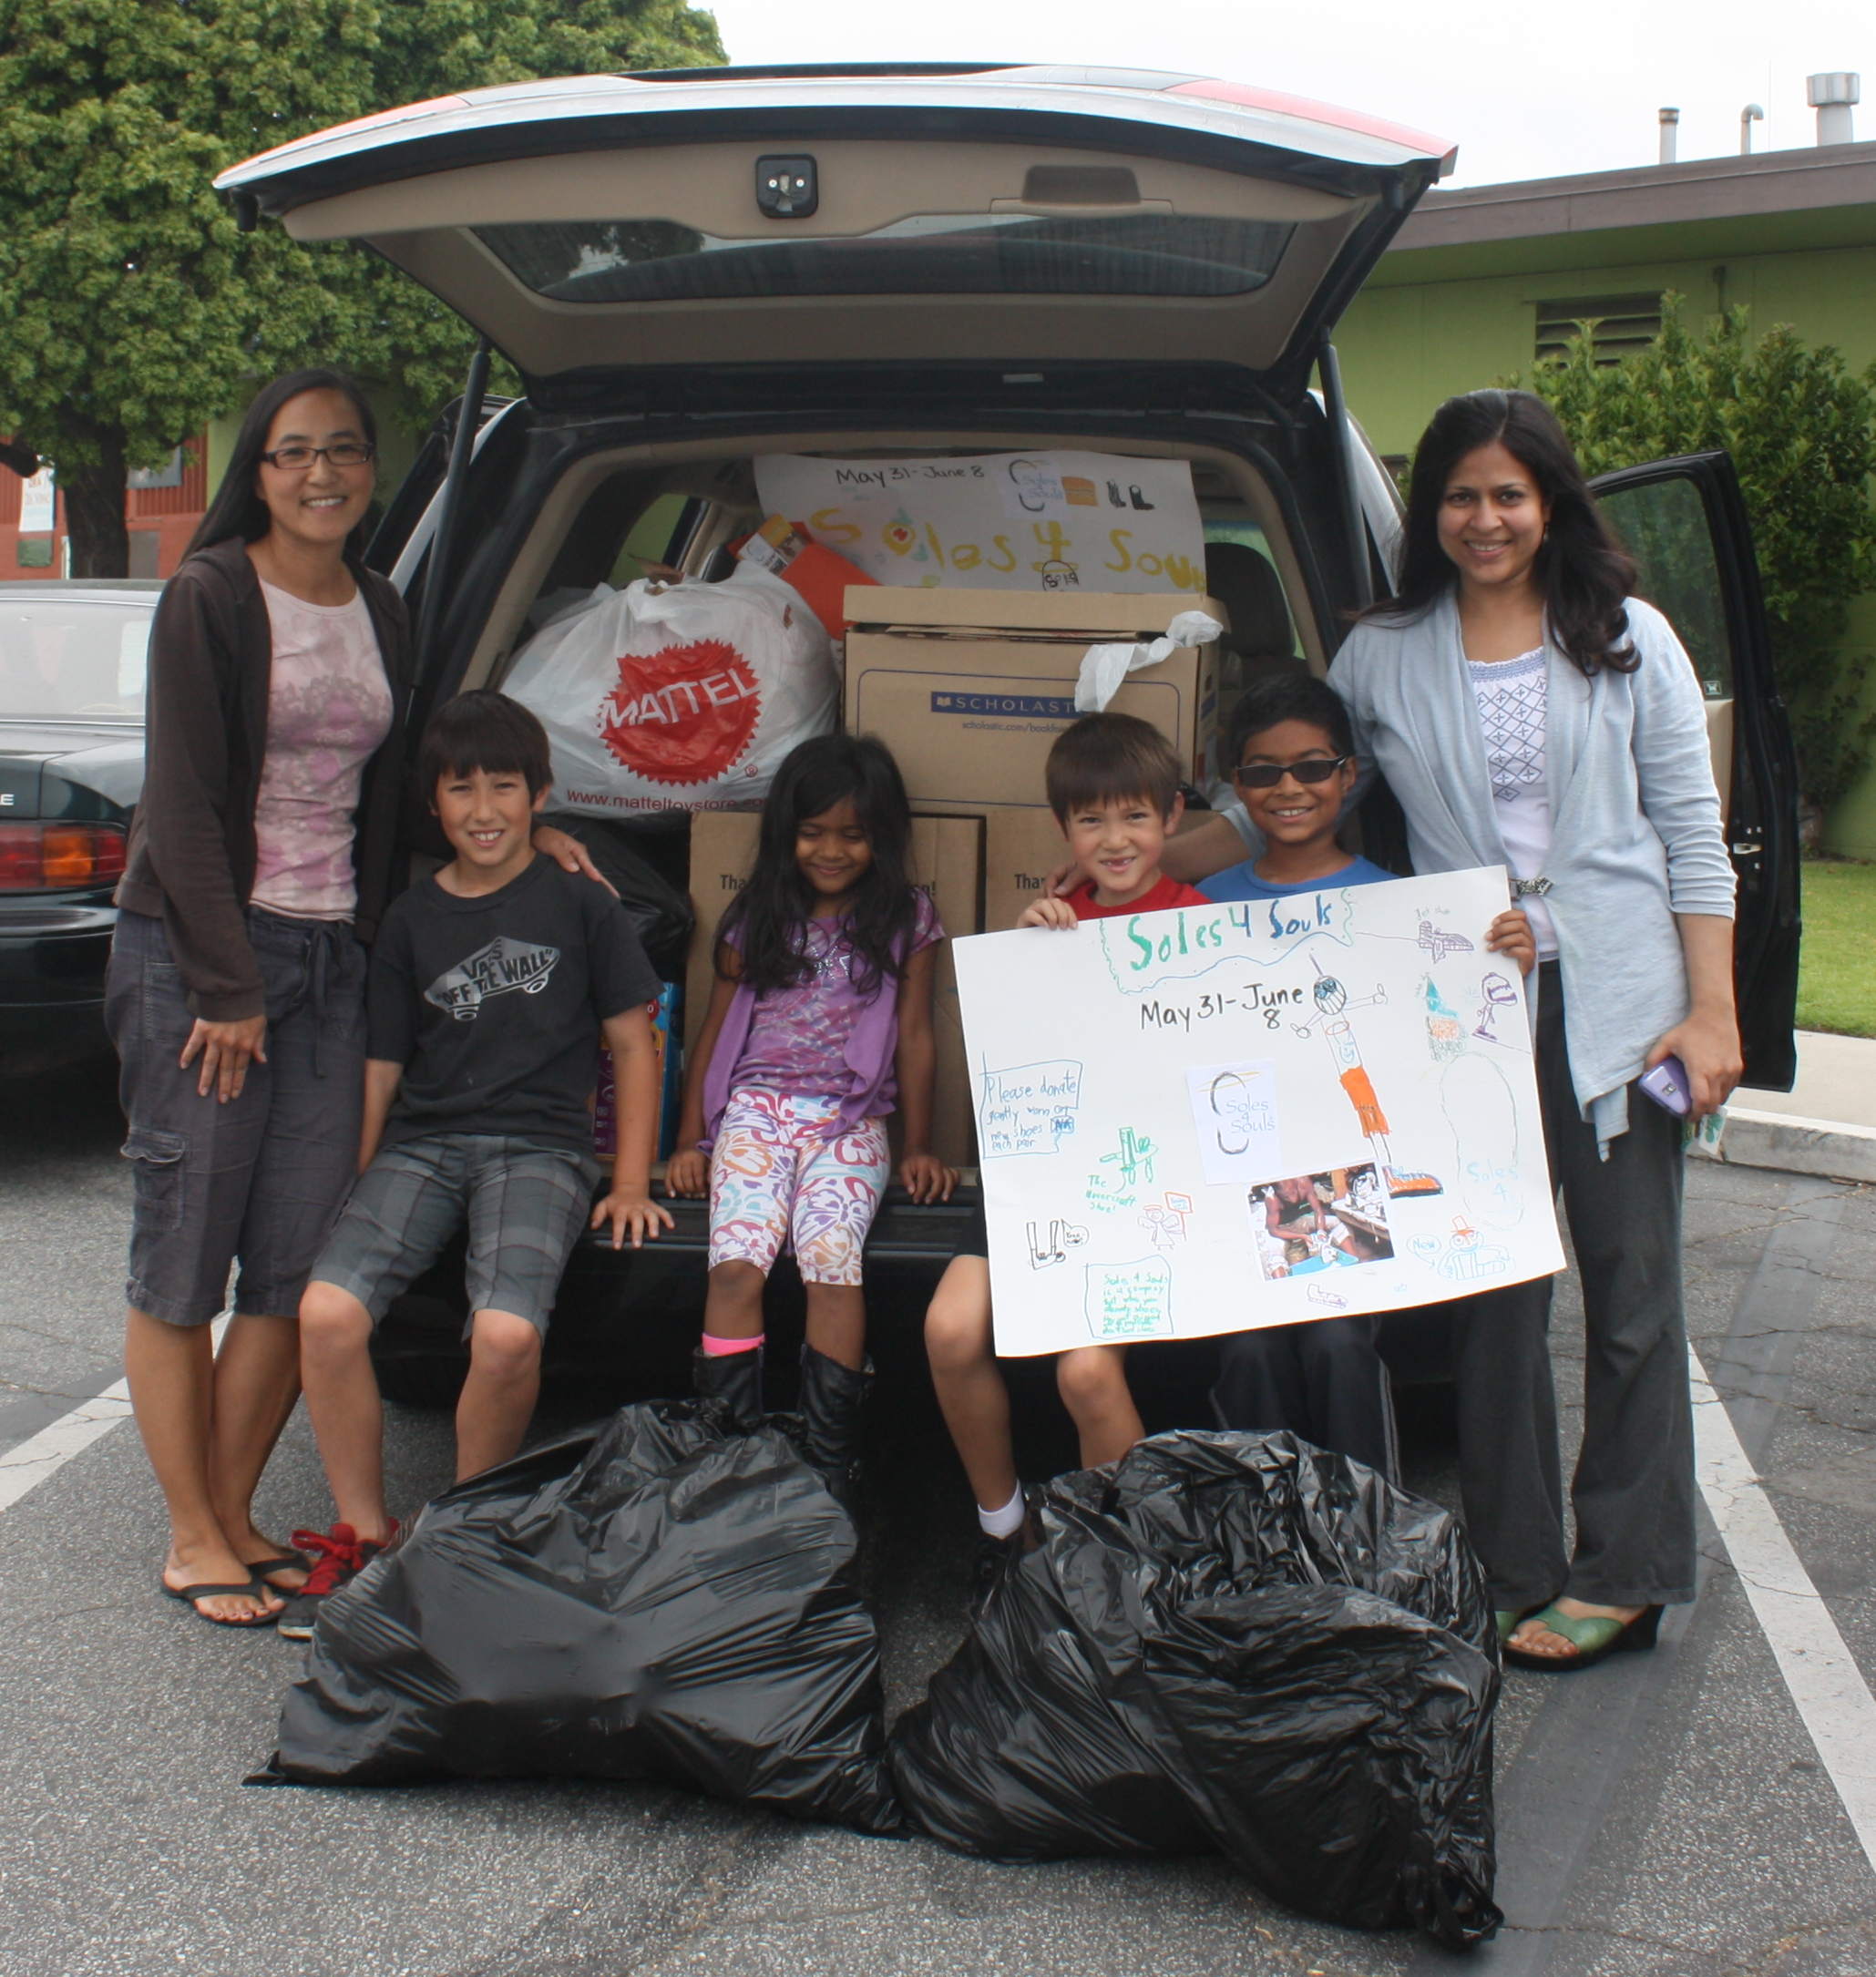
Family Facilitated Learning
Families are an integral part of their children’s education and are valued as contributing members of this learning community.
Families play a primary role in facilitating student learning. You may find this to be a challenge; however, we are here to support you. Please make sure that you take time for yourself to plan fun and engaging lessons. Families are more successful when they join other homeschooling families for collaboration.
YOU are not alone!
How can we support each other?
Pair up with a Mentor Family before you leave!

Slide 8
How to Join “Remind 101”
                Text @davincicore2 to 81010
                OR
                Email
                dviacore2@mail.remind.com

